Slide 1
Selection Sort

Slide 2
Selection Sort
01
An in-place sorting algorithm uses constant space for producing the output (modifies the given array only).
02
03
Arrangement of data in ascending or descending order refers Sorting
Selection Sort is an sorting algorithm which sort the data with an easiest approach
It is inspired from the way in which we sort things out in day to day life
It is an in-place sorting algorithm
it uses no auxiliary data structures while sorting (No extra space used)

Slide 3




Example
01
An in-place sorting algorithm uses constant space for producing the output (modifies the given array only).
02
03
Consider you have 4 shoes pairs with sizes 6 to 13.
You find them not in order.
Their arrangement from smallest to largest will be an example of selection sort.

Slide 4
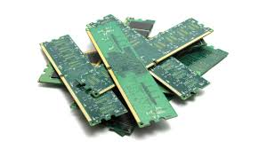
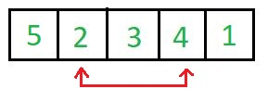
Real Life Application
01
Selection Sort
02
03
Only O(N) swaps can be made or is a requirement
In Place Sorting
When memory write is a costly operation in terms of time or hardware durability.

Slide 5
Selection Sort - Working
01
Pseudocode
02
for (i = 0 ; i < n-1 ; i++)
index = i;
for(j = i+1 ; j < n ; j++)
if(A[j] < A[index])
index = j;
temp = A[i];
A[i] = A[index];
A[index] = temp;
03

Slide 6
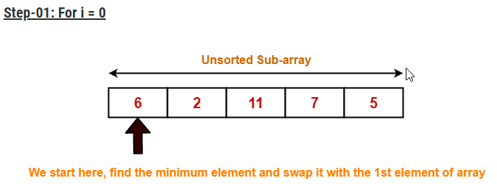
Selection Sort - Working
01
An in-place sorting algorithm uses constant space for producing the output (modifies the given array only).
02
It finds the first smallest element.
It swaps it with the first element of the unordered list.
It finds the second smallest element.
It swaps it with the second element of the unordered list
Similarly, it continues to sort the given elements.
03

Slide 7
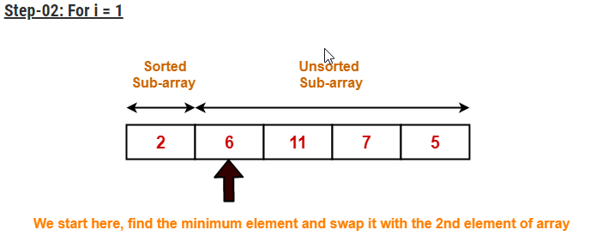
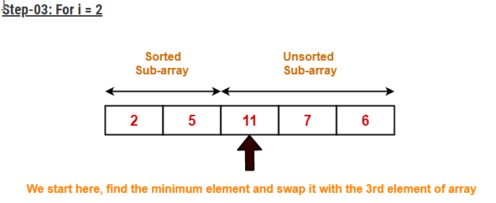
Selection Sort - Working
01
An in-place sorting algorithm uses constant space for producing the output (modifies the given array only).
02
03

Slide 8
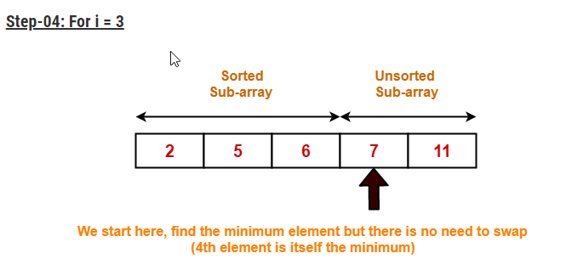
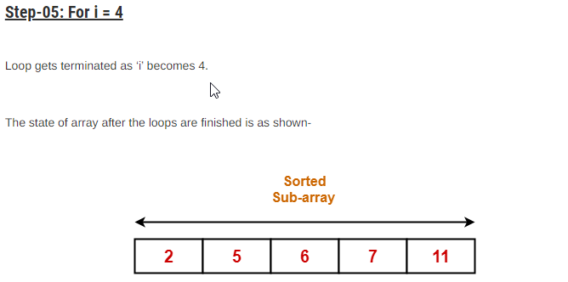
Selection Sort - Working
01
An in-place sorting algorithm uses constant space for producing the output (modifies the given array only).
02
03

Slide 9
Merits & Demerits
01
Selection Sort
02
03
In-place sorting, takes O(1)
performs well on items that have already been sorted
its inefficiency when the input size increases
its performance decreases

Slide 10
Complexity Analysis
01
Selection Sort
02
03
 | Worst Time | Average Time | Best Time
Time Complexity | O(n²) | O(n²) | O(n²)
Space Complexity | O(1) | O(1) | O(1)

Slide 11
Thank You

